Slide 1



Brainhack Dallas 2019
Saturday Nov. 16-Sunday Nov. 17

Slide 2
Welcome

Slide 3
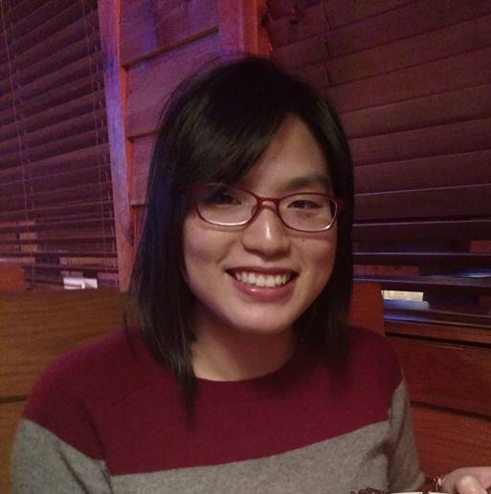
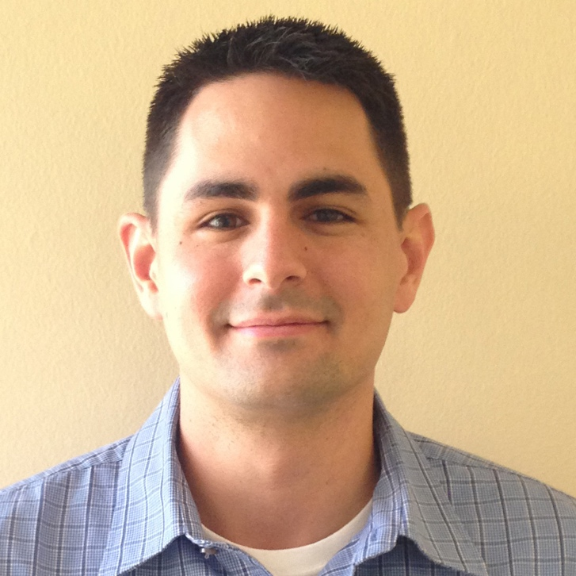
Introduce the Team
Ekarin
.
Made website
..
(Will talk about
R/Rstudio if you
let him)
Ju-Chi
.
Logistics with BBS
..
(Not your TA today)
Matt
.
Talk about data
visualization
..
(He is a Dr. !)
David
.
Advocated for food
..
(He likes food)
Micaela
.
Teach
Git/GitHub
.
(….)

Slide 4
The purpose of Brainhack?
Hackathon
Sprint-like event that aims to create a product in a collaborative manner. Often has specific focused themes.
Brainhack
Neuroscience-related hackathon
+
Talks | Tutorials | Panels | Unconferences
Notes:
BrainHacks are collaborative events that focus on the open sharing of ideas, models, code, and data. They bring together brain experts and enthusiasts from a variety of backgrounds to build relationships, learn from one another, and collaborate on projects related to the neurosciences

Slide 5
Schedule
Talks/Tutorial
.
Open Hacking Session
.
(repeat)
https://brainhack-dallas.github.io/mini-brainhack-utd/

Slide 6

Logistics
2 main rooms
Most talks will be in this room (larger classroom)
Git & GitHub Tutorial will be in the smaller room next door
Open-Hacking will be in both rooms when no talks are co-occurring
Lunch is provided (thanks to BBS)
Slack for communicating
Everyone was sent an invitation.
Have Slack it opened as a browser tab or install the Desktop version
Have notification turn on for #bhd-19 channel
Dinner – LA Burger after first day
Please indicate on the #bhd-19 channel on Slack if you will join us

Slide 7
Code of Conduct
https://www.brainhack.org/code-of-conduct.html
Be nice ☺
Notes:
Variety of experience and expertise

Slide 8

Goals
Learn some stuff | Make some stuff
Have fun
Hopefully we can do it again ☺
Notes:
* Feedback form after the event to help organizing the next one

Slide 9
Preparing to work on projects together
Install necessary software
Quick introduction on using GitHub to work on the projects together

Slide 10
Install & Setup
Git
Windows users: https://gitforwindows.org/
Git for windows comes with Git-Bash (a bash terminal for windows).
Linux/Mac Users: https://git-scm.com
GitHub
Sign up for an account on https://github.com
GitHub Desktop
Install GitHub Desktop: https://desktop.github.com/

Slide 11


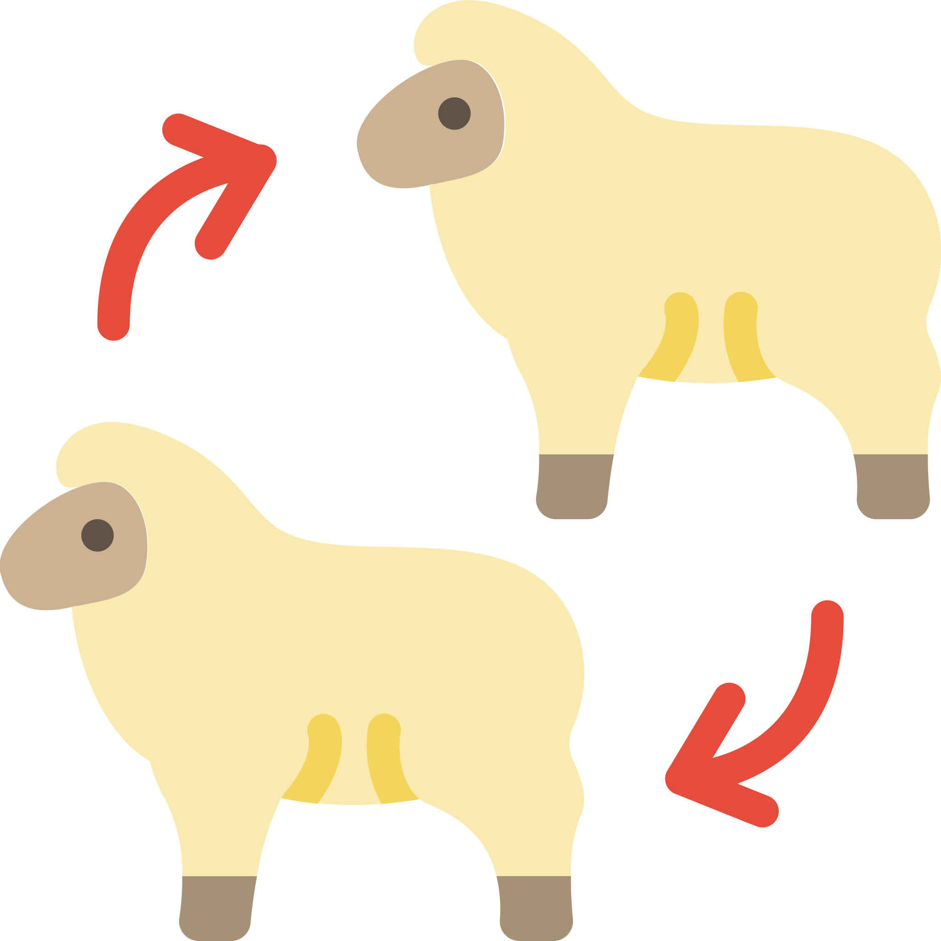

The process of collaborating on projects using GitHub
Add & Commit Changes
Fork the project repo on GitHub &
Clone it to your computer
Track your changes using Git
Push changes to GitHub
Make a
pull request
The original owner of the repository can review your changes before incorporating it

Slide 12
1. Obtain the project you want to work on
Fork a project so a repository of that project is now in your GitHub account
Fork the project repo on GitHub
Clone the repository to your computer
Use GitHub Desktop
File >> Clone Repository
Clone it to your computer

Slide 13
Look at what has been done in the project
History tab in GitHub Desktop
Notes:
git log

Slide 14

2. Make changes & document the changes
Add a file….
Look at what has changed
Change Tab on GitHub Desktop
Commit the change
Type a summary and click
Add & Commit Changes
Track your changes using Git

Slide 15
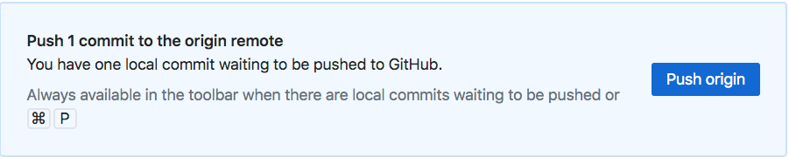
3. Push that change to GitHub
Push changes to GitHub

Slide 16
Check that your changes are now on GitHub

Slide 17
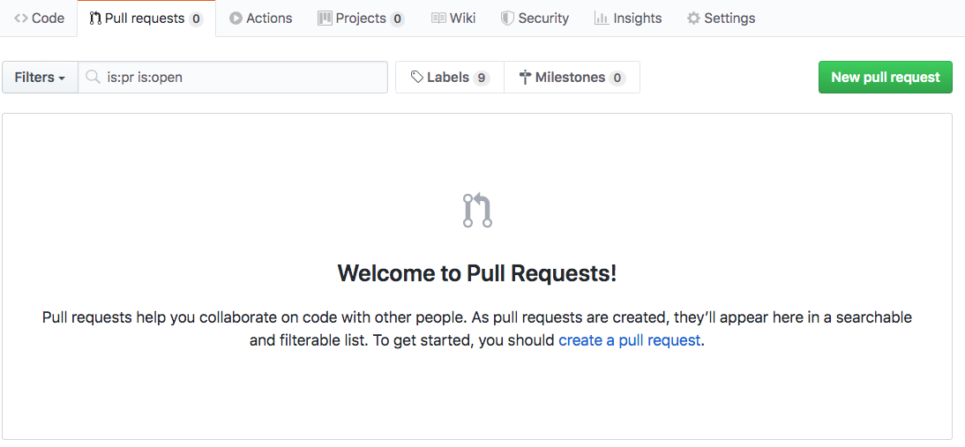
4. Ask the original author to incorporate your changes
Make a
pull request

Slide 18
Add & Commit Changes
Fork the project repo on GitHub &
Clone it to your computer
Track your changes using Git
Push changes to GitHub
Make a
pull request
For the purpose of this Brainhack, you don’t have to touch the command line if you don’t want to.

Slide 19
Projects
Can I pitch a project?
Yes.
What is the criteria?
The outcome of it is something open-to-all at some point
A tool/script/function
Processed data that is open
A tutorial/textbook
You (or a group) can pitch something mid-way through the Brainhack!
Notes:
The project doesn’t have to be self-contained within this Brainhack. Although it will be ideal to have a pause-point/chapter done within this event.
If pitching something brand new, expect some brain-storming time. Accept ideas from others joining you. Build a rough road-map with bite-size steps that can be delegated to others (e.g., organize example data, organize resource list, create an outline, make example scripts).

Slide 20
Project Pitch

